Slide 1

The easiest way to get paid – VIA “APP”

Slide 2
Business opportunity
Mobile devices are increasingly used for payment processing, but current solutions still require the use of additional hardware before taking payments.
PAYYAP has created a revolutionary payment “App” that offers faster, safer payments -- without the use of Squares, dongles, or hardware plugins of any kind.
PAYYAP is first to market with this merchant-initiated, automated-voice driven payment channel – “the 6Th payment channel”.

Slide 3
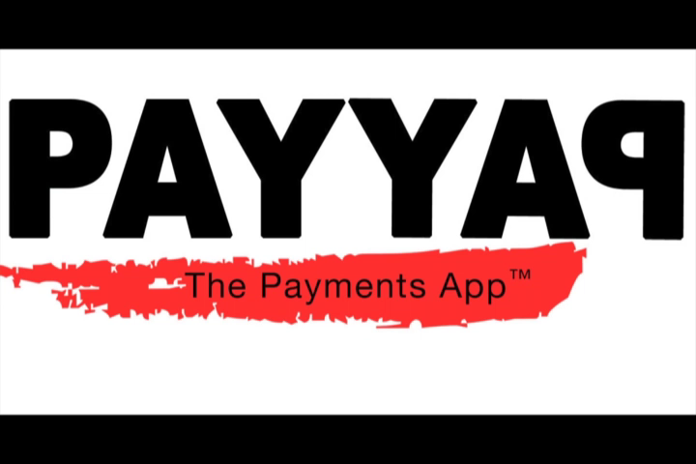
How it works
(video example)

Slide 4
bank card
INDUSTRY TIMELINE
MAR, 1950
DEC, 1998
FEB, 2009
AUG, 2016
Diner’s Club revolutionizes consumer payments - first to make consumer credit easy by launching a “travel charge card” for card-present, face-2-face credit charges.
PayPal revolutionizes consumer payments - first to make remote, card-not-present web commerce easy and available to the masses.
Square revolutionizes consumer payments - first to make card present, face-2-face transactions easy and available to the masses -- with mobile hardware.
PAYYAP revolutionizes consumer payments – first with face-to-face and remote payments via mobile APP -- zero hardware, “6th Channel” technology & services.

Slide 5
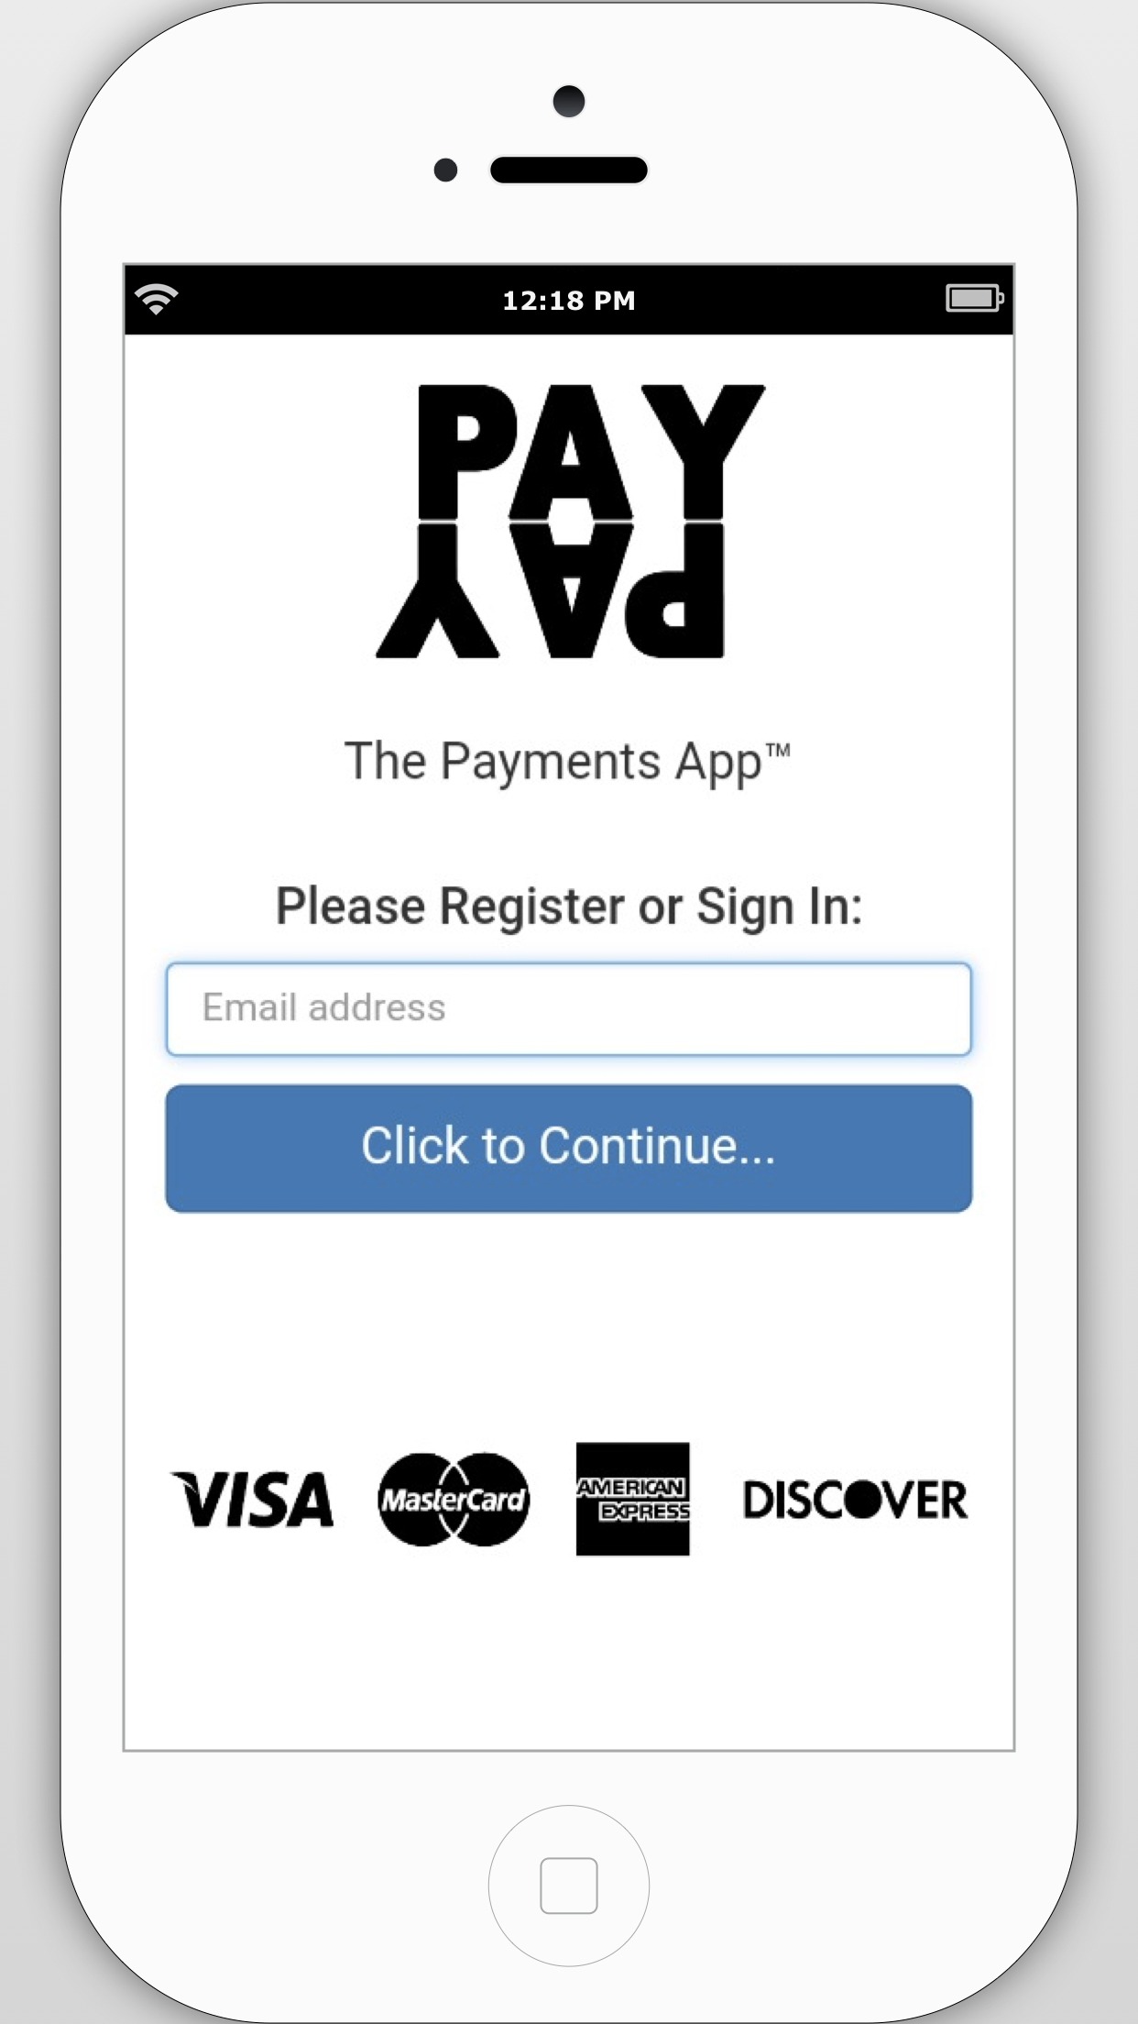
Bank card
INDUSTRY niche
Channel #1 : Face-to-face transactions via SWIPE & SIGNATURE
Channel #2 : Remote transactions via WEB
Channel #3 : Remote transactions via EMAIL
Channel #4 : Remote transactions via TELEPHONE
Channel #5 : Remote transactions via SMS
Channel #6 : Remote (& Face-to-Face) transactions via “APP”
PAYYAP is first to market w/ zero-hardware (“pure App”), 6th Channel Technology & Merchant Services

Slide 6
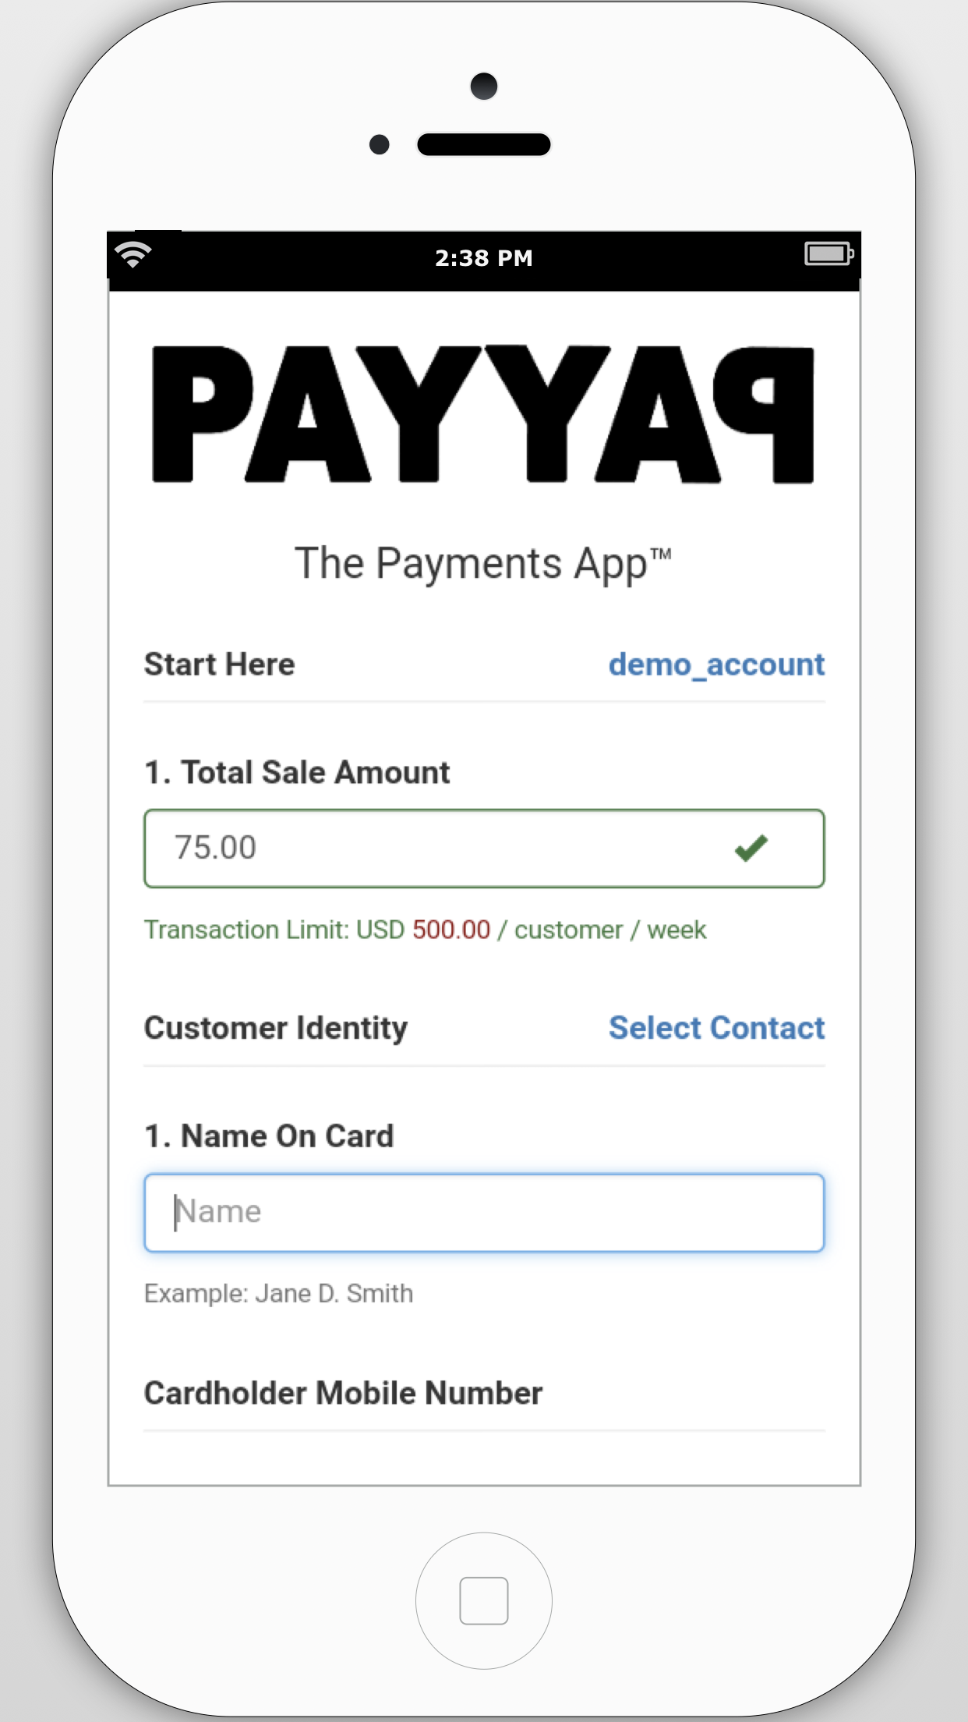

Simply, Merchant-Driven
A
STEP 1 / 3:
Merchant “opens” the PAYYAP mobile App and sets the Customer’s information:
Amount to be Paid
Name
Telephone Number

Slide 7
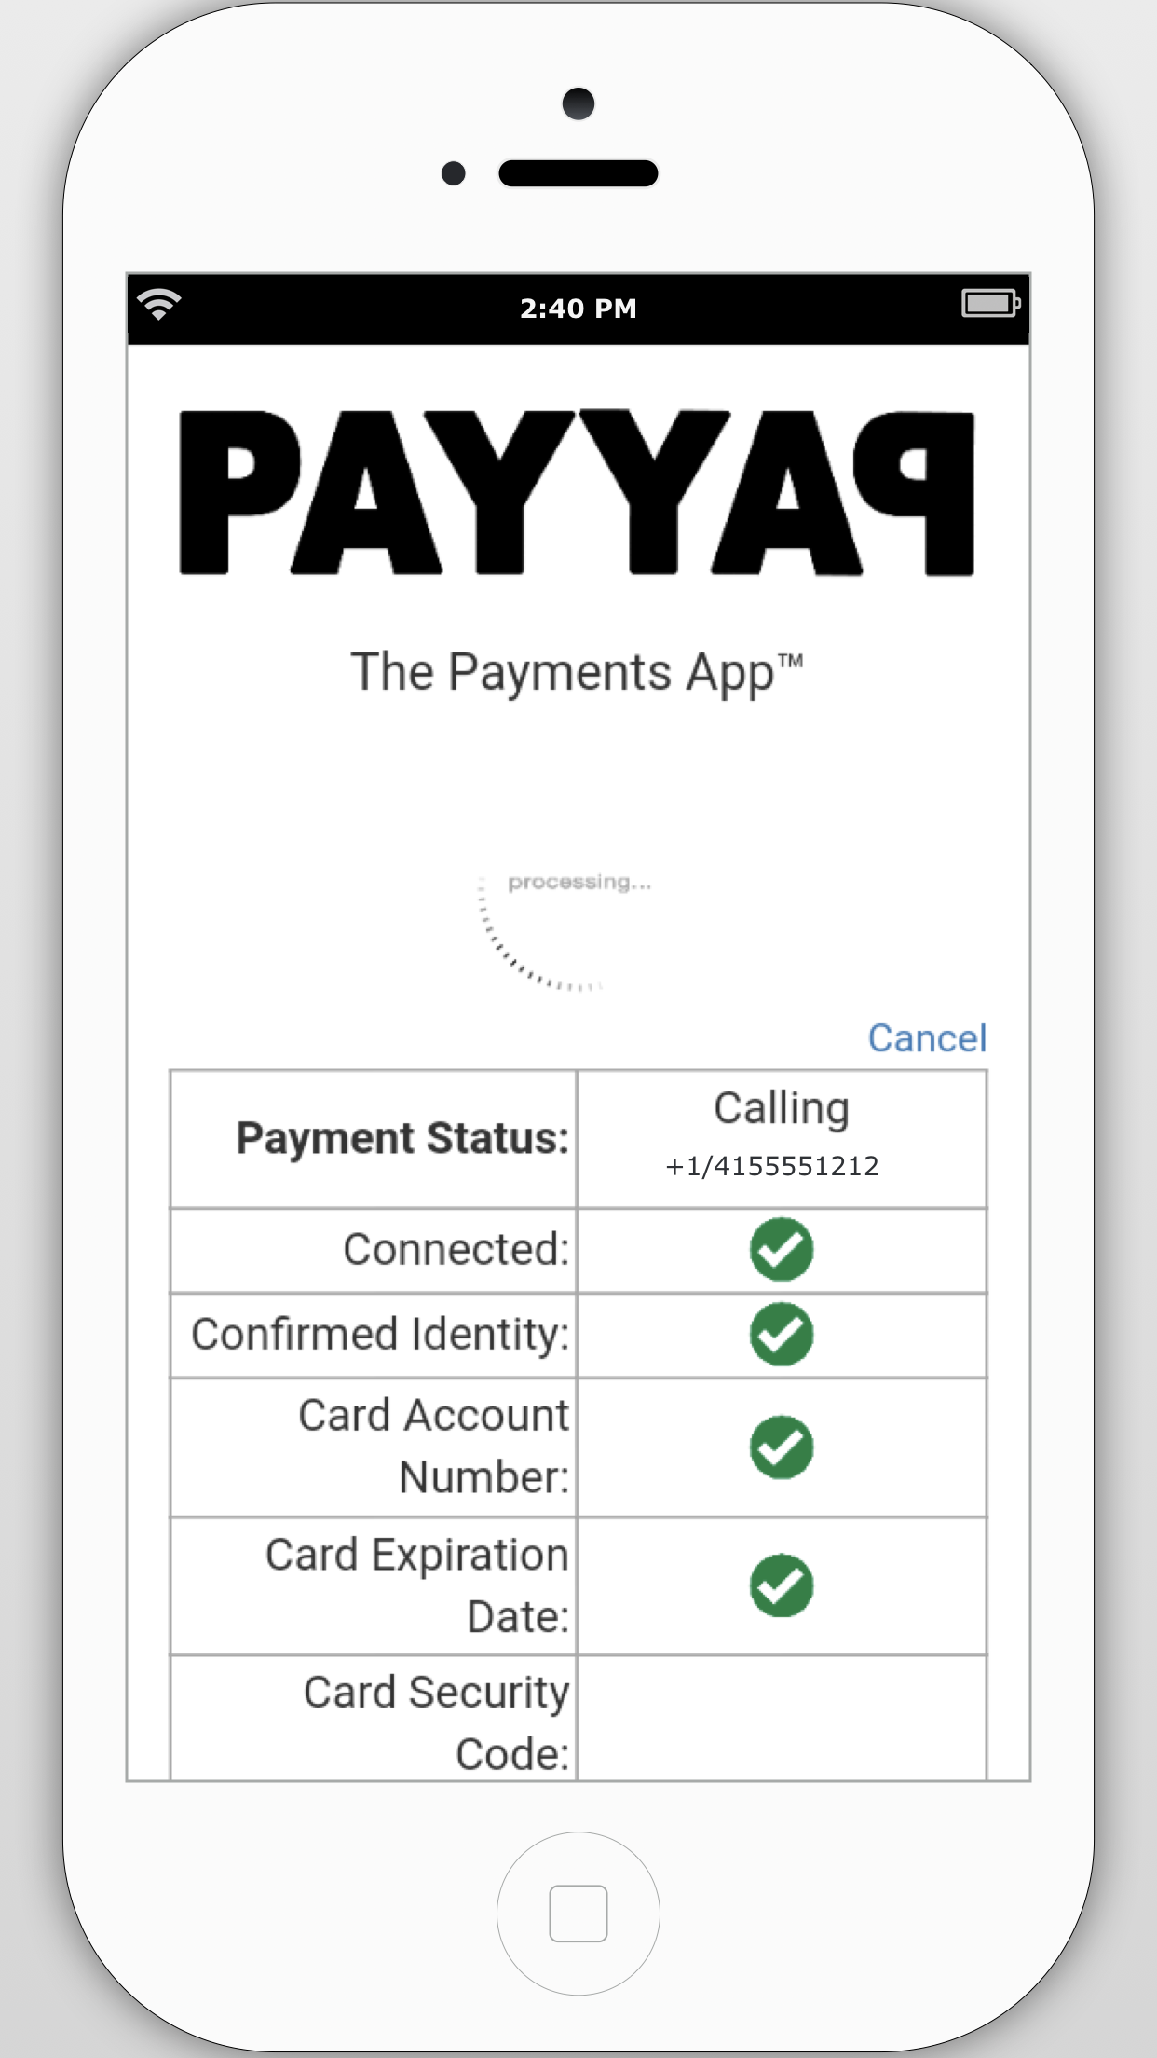
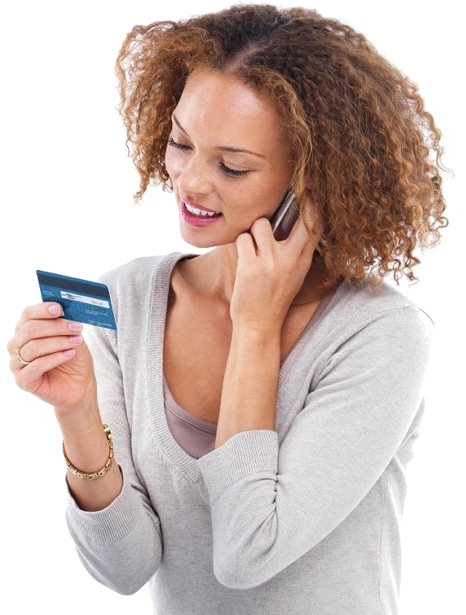
Customers receive a friendly, automated telephone call…
B
STEP 2 / 3:
PAYYAP voice servers place a call to the Customer’s phone
The automated PAYYAP operator secures the customer’s card data in real-time…
Over any normal telephone (i.e., “offline”), and within a fully PCI/DSS-Compliant security environment

Slide 8
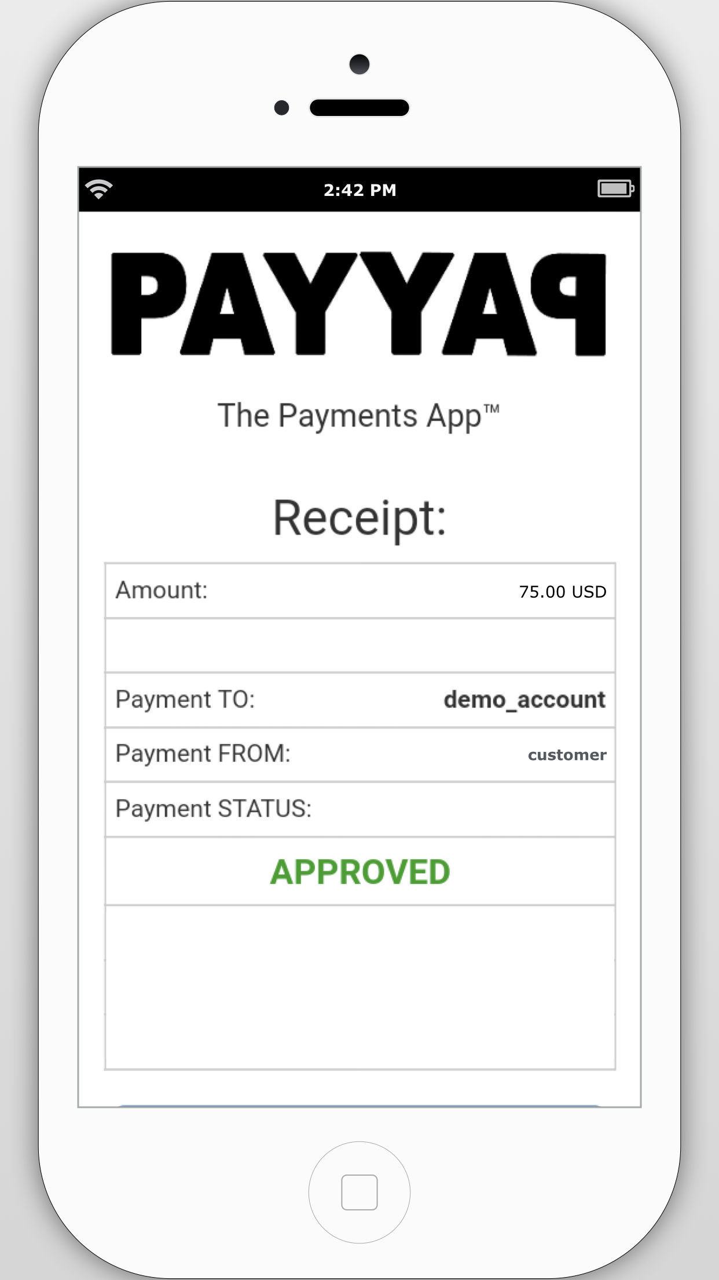
Merchants receive voice authorized, real-time payments
C
STEP 3 / 3:
PAYYAP Payment Features:
Real-time status display
Voice-recorded (digitally signed) payment authorizations
Payment receipt when transactions are approved

Slide 9



Distribution
PAYYAP is a free mobile App that can be downloaded from any of the major mobile App stores
LIVE DEMO ACCOUNT CREDENTIALS:
  USER: demo@corp.nsdb.com
  PASS: demo

Slide 10
- PAYYAP IS LIVE & CASH-FLOWING -
PILOT METRICS: Strong & STRONGER Demand
USA Metrics (LIVE)
International metrics (PAUSED)
1,000+ Registered Vendors (downloads)
20+ Processing Accounts
$10,000+ Total payment volume…and counting!
1,000+ Registered Vendors (downloads)
200+ Processing Accounts
$100,000+ Total payment volume (paused)

Slide 11
Competitive analysis
 | Pricing | Markets | “Payer” Considerations | Advantage
PayPal | 3.1% + $0.30 (+ $30.00 / month) | Global | Must have access to the internet | Economy of scale; Ability to quickly buy innovators
PAYYAP | 2.60% - 3.35% (+ $1.00 bank deposit fee) | Global | Any telephone | Easiest way to get paid over telephone; First mover advantage
Square | 2.75% - 3.75% | AU, JP, US, UK | Regionally limited; Must have access to the internet | It was a first mover in the mobile “card swipe” market
venmo | 3.0% | US | Must have venmo App; Regionally limited | Free bank to bank transfers
Western Union | 5% - 50% | Global | Time consuming; Expensive | Cash-In / Cash-Out

Slide 12
Global Mobile Payments Industry
The main drivers accelerating industry growth are lower cost, quick transactions, high consumer reach, ease of payment and rising smartphone penetration levels.
PAYYAP Positioning:
First mover advantage.
Scalable across multiple payment channels & languages.
High convenience addresses target customer needs.
PAYYAP’s Target Market
Entrepreneurs and small businesses (especially those using online marketing and sales channels) who are looking for convenient ways to take payments from remote customers – immediately!
Geographic Markets: Worldwide (English speaking)

Slide 13
Value proposition
Value to Businesses
Value to Customers
  The easiest way to get paid.
  Recorded voice authorizations reduce fraud and disputes
  Real-time payment completion
  Auto-payment receipt (via email or sms when available)
  Available worldwide
  No desktop / laptop / tablet required
  No internet required / no Apps to download
  Receiving an automated telephone call is familiar & free
  Quick payments by speaking to an automated operator or using the phone’s keypad
  Voice biometric security enables fast repeat use

Slide 14
Management team
Shea Writer
Founder; CEO
10+ years of experience as a successful entrepreneur in the field of internet technologies.
Multi-national patent holder in the field of remote identity verification.
Experienced in taking product ideas from inception to market launch (photo.BANGK!, Peephole.Online, and more.)
Peter Malliaras
Customer Support Manager
13+ years of experience owning and managing successful businesses.
4+ years experience with setting up a system for detecting online fraud in the online space for Myer.
Was an analyst in the Criminal Intelligence Unit for the Victoria Police Force
Mohammad Shahid Ulla
Sr. Software Engineer
8+ years of software design and development experience.
Proficient in the following programming languages: C#, ASP.NET, MVC, PHP, Java, Objective C, MS SQL Server, MySql, HTML, CSS, JS, jQuery, UML and more.

Slide 15
Financial summary & investor return
 | Year 1 | Year 2 | Year 3
NET REVENUE | $ 140,468 | $ 6,105,983 | $ 26,234,168
Operating Expenses | 1,701,665 | 5,103,360 | 5,013,360
EBIT | $ (1,561,197) | $ 1,002,623 | $ 21,130,808
Investment Amount | $ 500,000
Investor's Equity Position* | 20.00% | 14.00% | 14.00%
EBIT Acquisition Multiple | 10.0 | 10.0 | 10.0
Market Value of PAYYAP | $ 2,500,000 | $ 10,026,231 | $ 211,308,081
Investor’s Market Value | $ 500,000 | $ 1,403,672 | $ 29,583,131
 | Investor ROI (year 3 exit) |  | 58X
*Takes into account a second round of financing with an anticipated investment of $3,000,000 at a $10,000,000 post-money valuation.
$500,000
20% Equity
Investor Exit through Company Acquisition

Slide 16
Use of funds
$500,000
Current Round
$3,000,000
Next round
Primary purpose is to bring on technical staff to complete back-end preparation to launch into international markets (Spanish or Chinese)
Primary purpose is to bring on more technical & support staff and to aggressively ramp-up marketing & advertising efforts domestically and abroad.

Slide 17
The Payments app™
Shea Writer
Founder CEO
email: shea.writer@payyap.network
phone: 917.310.0864

